Slide 1

Year 5
Information Meeting

Slide 2
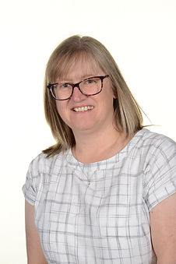
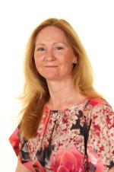
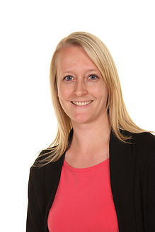
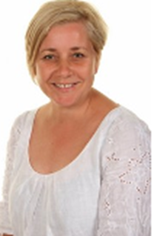
Staff
Mrs Simpson
Year 5 Teacher
Miss Cavill
Year 5 Teacher
Mrs Maddison
Head Teacher
Mrs Yates
Assistant Head Teacher

Slide 3
The School Day
The gates open at 8:45 and the children can come straight to the Year 5 classroom. They come in through the gate towards the field and turn right. The Year 5 classroom is the second on the right.
There are pegs in the classroom for their coats and lockers are outside the classroom for them to store their bags. They share a locker with 1 or 2 others. Packed lunches are stored on a trolley in the street/hall. After lunch, they are put on their lockers ready to go home. Children will also need to bring a water bottle to school each day.
The school day ends at 3:20. Children should be collected from the school gate or can walk home by themselves if an email or letter has been sent to school confirming these arrangements.

Slide 4
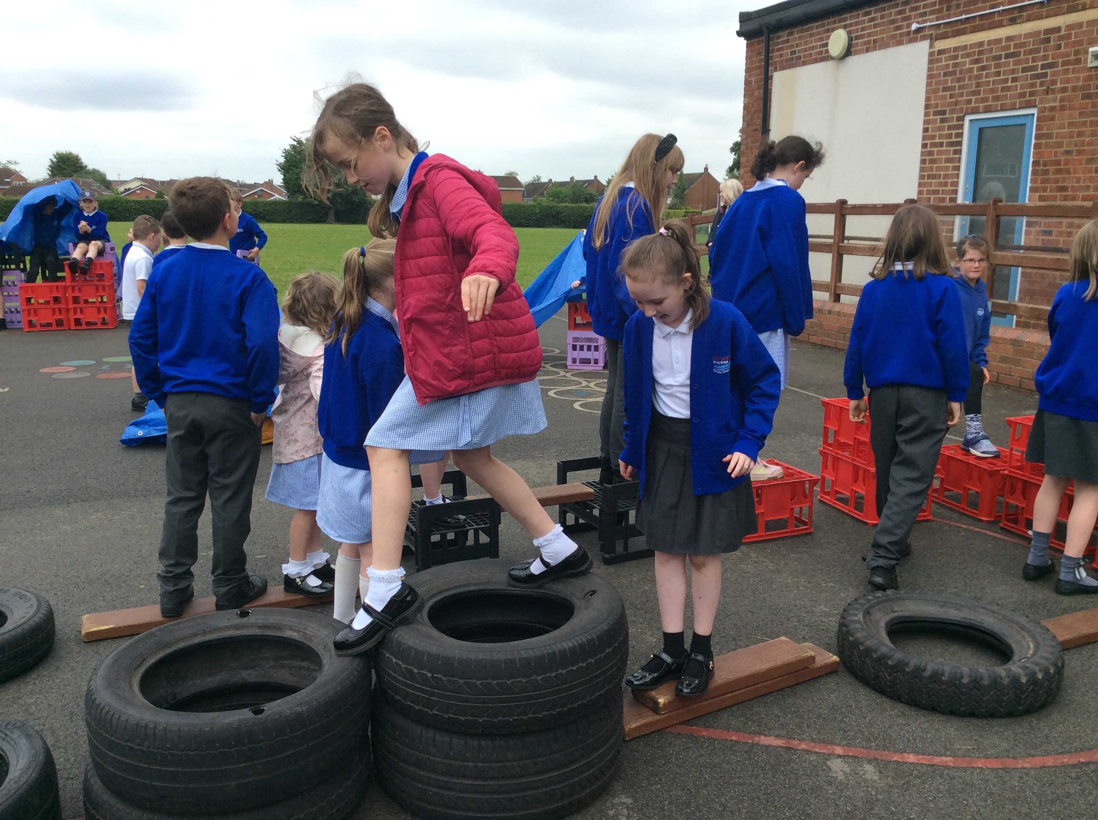
Daily Routines
Playtimes
Lunchtimes
10:30-10.45 with Years 3, 4 & 6.
One playtime each week will be on the MUGA.
Children are welcome to bring in a nut- & sesame-free, healthy snack (e.g. fruit or vegetables).
Children should bring water in each day &, as a minimum, they will be encouraged to use play- and lunchtimes for drinks, as well as toilet trips.
Our lunchtimes run from 12:00 – 1:00.
We run a family system, where each family of children from across the school eats and plays together.
At lunchtimes, the children can play across all of our areas.

Slide 5
Uniform
Our school colours are royal blue, white and grey.
Branded items can be purchased from Brigade. However, no branded items are compulsory.
Uniform expectations:
  Royal blue sweatshirt or cardigan
  Grey skirt, pinafore, trousers or shorts
  White polo-shirt
  White or grey socks/black or grey tights (with skirts or pinafores)
  Sensible black shoes (no high heels/wedges, sandals or trainers)
  Blue and white gingham dress
Please make sure that all jumpers, cardigans, coats, hats and gloves are named.

Slide 6
Uniform
Jewellery: For reasons of health and safety, jewellery is not to be worn at school. In those cases where children have pierced ears and need to wear earrings to school then these should be one set of single studs only. Smart watches should not be worn in school. Simple analogue or digital watches are permitted, but should not be used as a distraction.
Hair: Children should have smart hair cuts. Radical designs and hair dye are strongly discouraged.
Make Up: It is not appropriate for children to wear make-up or nail varnish.
We aim to avoid designer products (bags, coats, water bottles).
Notes:
e.g. Stanley Cups, Air Up bottles

Slide 7
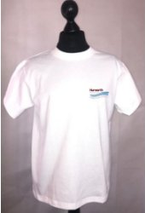
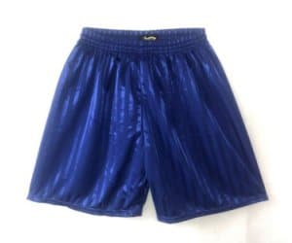

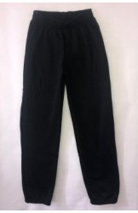
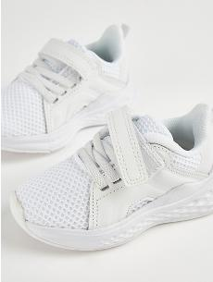
PE
Thursday is PE day.
Children should come to school in their PE kit.
They will need appropriate clothing for the weather (sunhats for warm weather, waterproof coats and hats for cold weather.
All jewellery must be removed before PE. If your child is wearing earrings, please ensure that they can remove their own or you provide plasters to cover them.
Please avoid fashion, branded or patterned sportswear.
Please make sure that all hoodies are labelled with your child’s name.
Royal blue shorts
White T-shirt (available with school logo)
Royal blue hooded sweatshirt (available with school logo)
Long, plain jogging bottoms or leggings
Trainers

Slide 8
National Curriculum
English (writing, reading, spelling/phonics, handwriting)
Maths
Science
Computing
Music
PE
PSHE
RE
Science
Geography
History
Art
Design Technology
Spanish (KS2 only)

Slide 9
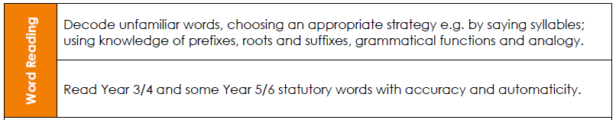
Reading Expectations

Slide 10
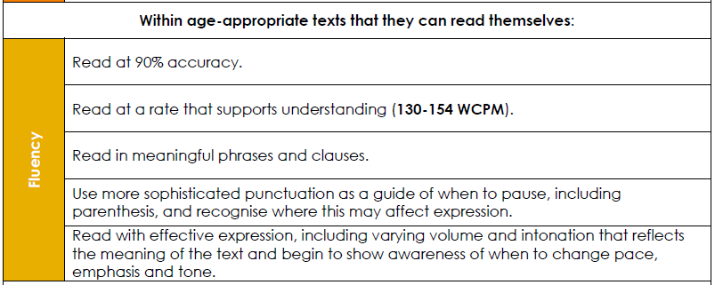
Reading Expectations

Slide 11
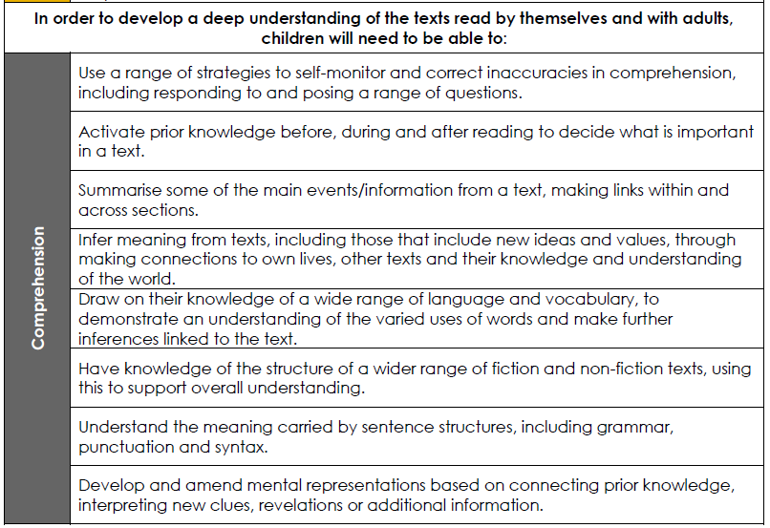
Reading Expectations

Slide 12
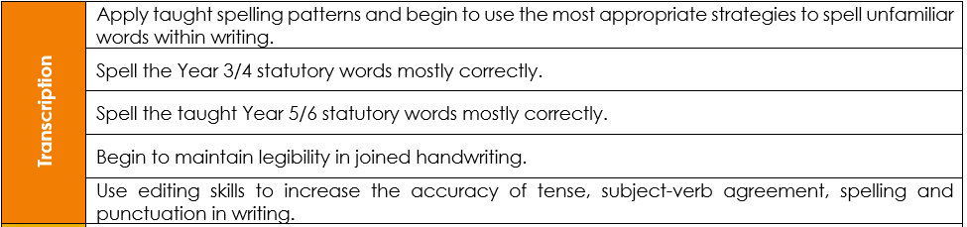
Writing Expectations

Slide 13
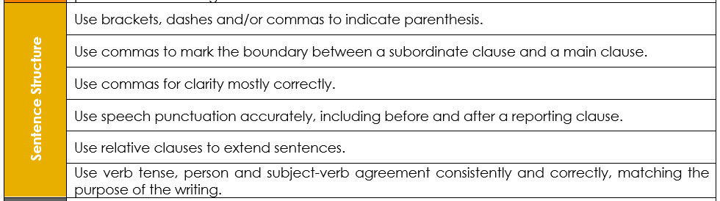
Writing Expectations

Slide 14
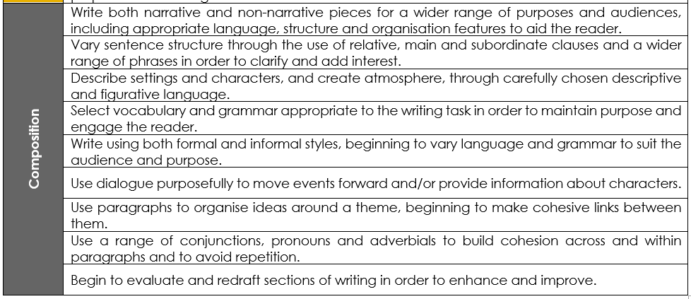
Writing Expectations

Slide 15
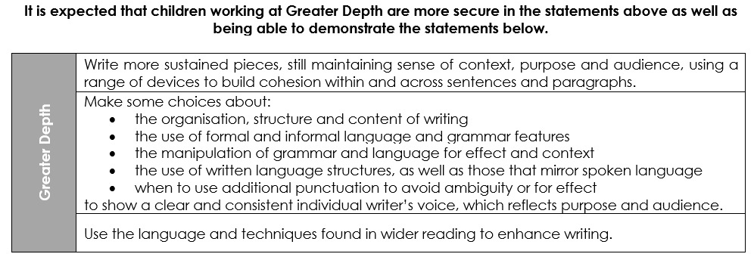
Writing Expectations

Slide 16
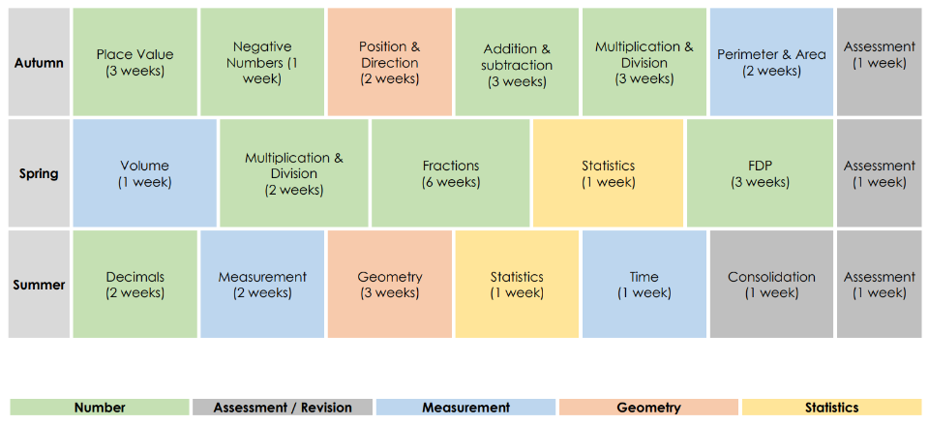
Maths Expectations

Slide 17
Maths Expectations
Read, write, order, compare and know place value of numbers to 1,000,000
Add and subtract numbers mentally and using formal written methods
Multiply / divide numbers mentally using known facts and use formal written methods
Compare and order, add and subtract fractions
Convert between and compare fractions, decimals and percentages
To find the perimeter and area of rectilinear shapes
To round to a given value
To translate and reflect points/shapes on a grid
To measure, draw, and calculate angles on a straight line and around a point
To identify factors, multiples, prime, square, and cube numbers

Slide 18
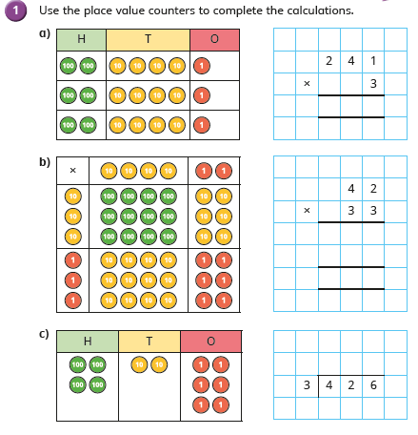
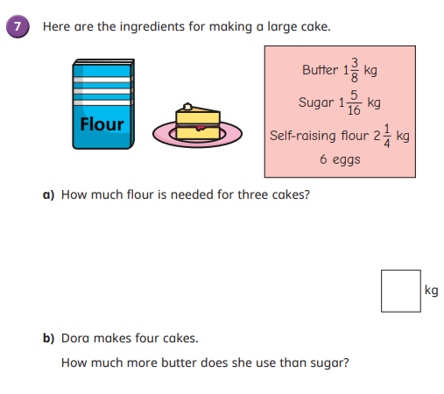
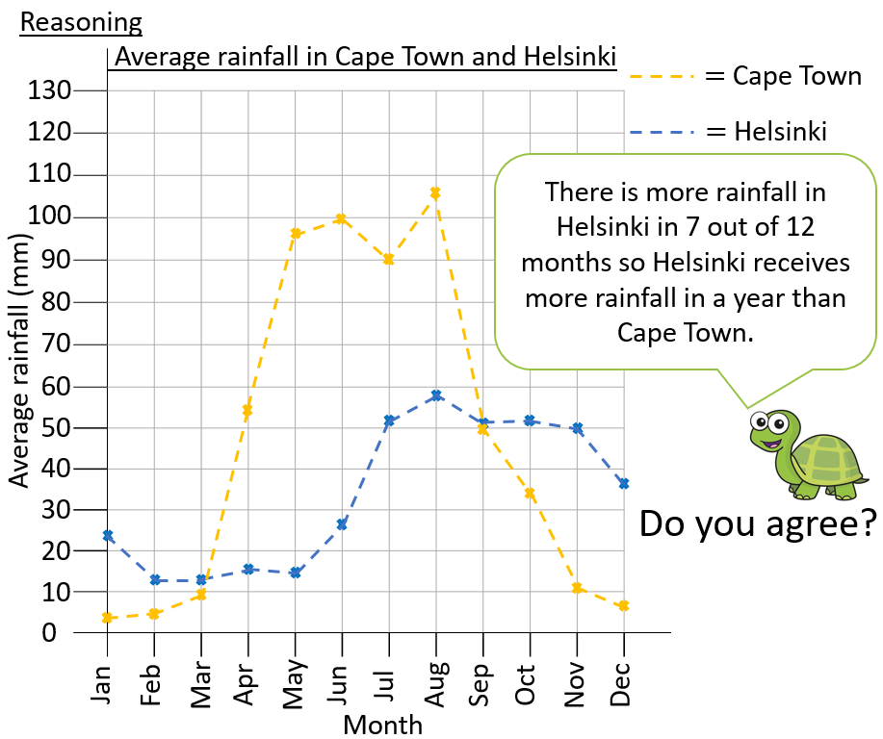
Maths Expectations

Slide 19
The Wider Curriculum
Space
Rock n roll dance
The North East
Swimming
Rivers
Word processing
Rounders
Life Cycles
Singing in harmony
Anglo-Saxons
Observational
Drawing
Hockey
Rainforests
Playing and composing
Changes in materials
Forces
Vikings
A more detailed overview will be added to the school website and emailed each term.

Slide 20
Homework
Homework is handed out on Monday and is expected to be returned on Friday.
The children are encouraged to use Times Tables Rock Stars for additional practice. They should know their logins for these but will also be given a reminder at the beginning of the year.
A new spelling rule will be given to the children on Monday. This will be practised five times in school through different activities. There will be a spelling quiz on a Friday – this will include 4 words from the given list, 2 using the same spelling pattern, 2 of the year group words and 2 words from previous weeks.
Most weeks, there will an arithmetic homework or reading homework too. Children should be capable of completing their homework independently. Please encourage your child to complete their homework before the day it is due in – then if they need support, they can ask at school. You will receive an emailed document with guidance for supporting your child with their spelling.

Slide 21
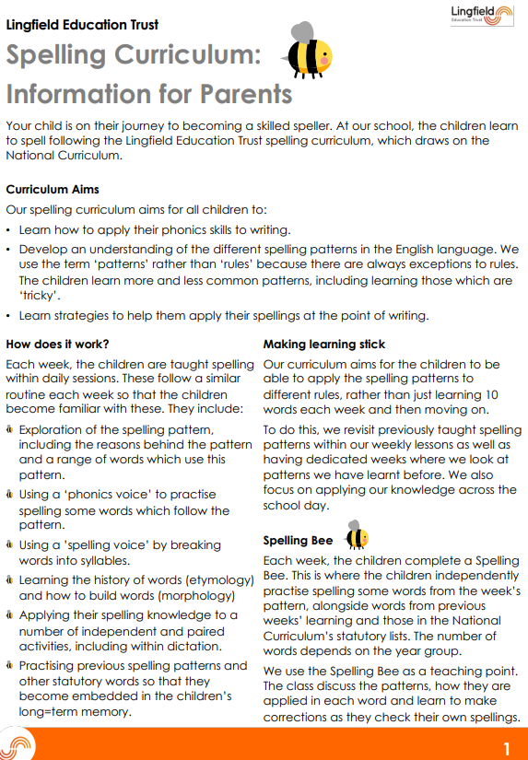
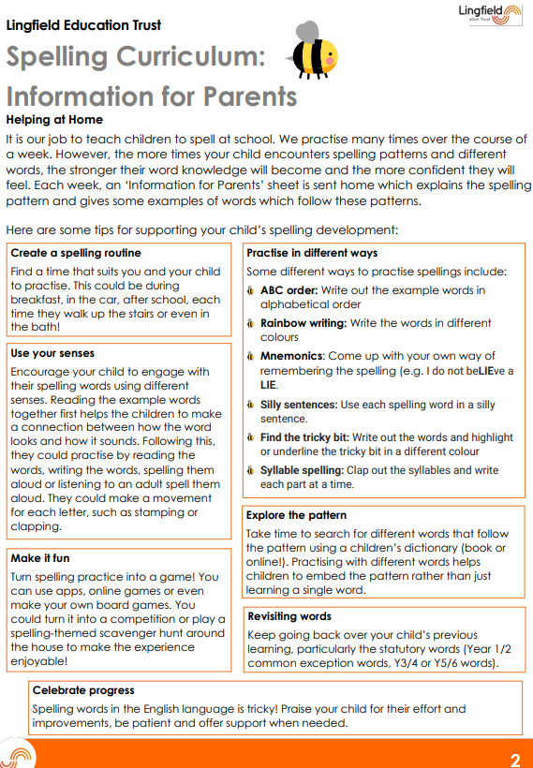

Slide 22
Reading at Home
All children are expected to read at least three times per week at home.
Children are welcome to choose their own books from our bookshelf or from the library, and can change it whenever they finish.
Children can record their own reading. Please can an adult check this and sign it off before reading records are checked each week. Reading records will be checked every Friday.
Children will also read in school throughout the week so please ensure their reading book and record are in their bags each day.
Children who have read three times will receive a bookworm treat and their names will be entered into our half-termly raffle to receive a book token.
Notes:
Model using the corner of the page to turn a book, rather than ‘swiping’.

Slide 23
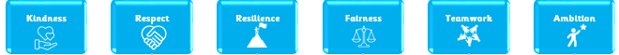
School Values
To support our children to be the best versions of themselves, we teach the children about our school’s six core values.
We recognise that, in society, not all people uphold these values and so we ask in your support in modelling and instilling these values at home.
Some examples include:
  Fairness and Respect: making sure that children of any gender are treated equally
  Kindness and Respect: making sure that nobody is judged for being different
  Resilience: knowing that it is okay to make mistakes; the important thing is to learn from them and move on
  Teamwork: knowing that everyone in our school family is part of our team
  Ambition: understanding that we should try to be the best version of ourselves

Slide 24
Independence
In order for children to develop our core values of resilience and ambition, we have certain expectations of what they should be able to do independently by the end of the year. We appreciate your ongoing support of these skills outside of school.
Year Four | Try a solution before giving up. ‘I can’t’ is not used. | Use a range of strategies before asking teacher for help, e.g. peer support | Follow multistep instructions given by teacher without the need to ‘double check’ | Bring homework back on time and completed | Check through answers to assessments thoroughly.
Year Five | Take responsibility and have pride in their own appearance, including their work | Support others when the need arises, using own initiative | Keep classroom resources ready to use and ensure that they are tidied away afterwards | Hand in homework which may have different deadlines during the week. Ensure they collect their own homework if they were absent on day it was issued

Slide 25
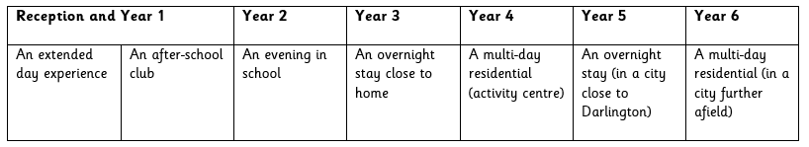
Trips and Experiences
To help to encourage the children to become independent, we are going to be providing a variety of clubs, trips and enrichment experiences.
In Year 5, some of our trips will include:
  Trip to Durham Cathedral on the train (enrichment)
  An overnight stay in York (residential/history)
  Oriental Museum (history)
One of our enrichment experiences will link to enterprise. The children will run their own activities to fundraise for one of their trips in each year group.
Our ‘Independence Away From Home’ Progression

Slide 26
Online Safety
Please ensure your children are not given a smart phone too soon. We advise that children are in at least upper KS2 before they have their own smart phone.
We know lots of children are accessing YouTube videos that are not suitable and games that are beyond their age range.
Please ensure parental controls are set on any device that your child has use of. We can help with this if you are unsure how to set them.
Use Parental Controls to Keep Your Child Safe | NSPCC
We advise to limit screen time.
Notes:
Ensure that children are not being given a smart phone too soon – we know children are accessing YouTube videos that are not suitable and games beyond their age range

Slide 27




Keep Up to Date
You can find out more information about what the children are up to in school through our social media accounts.
We also add termly information about the children’s learning and other useful information to the class pages on our school website: www.hurworthprimary.com
https://www.facebook.com/HurworthPrimarySchool/

Slide 28
Any questions?

