Slide 1



Personal
Development
Overview
“Children are not things to be
moulded, but are people to be unfolded.”
Jess Lair

Slide 2
School Values
At Hurworth, we live by our school motto of ‘Consider, Create and Contribute’, which is broken down into a set of six values – which are articulated, recognised, lived and taught. These values and ‘sub-traits’ are:
Supporting Documents:
Visions and Values
Values Progressions
Behaviour Policy

Slide 3

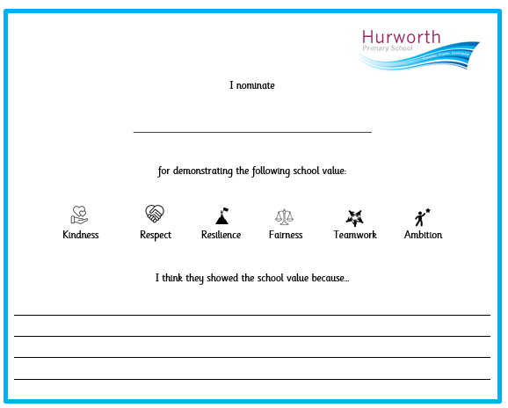
School Values
Rewarded through:
  Stamps
  Steps to Success
  Pupil of the Week
  Wows
  Nominations from peers
  Above and Beyond
  Pupil of the Year
  Outstanding Pupil
Taught through:
  PSHE
  RE
  Assemblies
  We Love to Read time
  The wider curriculum
  Enrichment

Slide 4
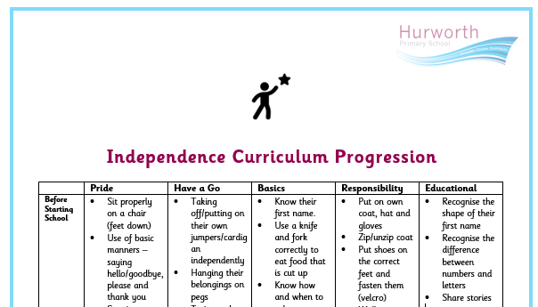
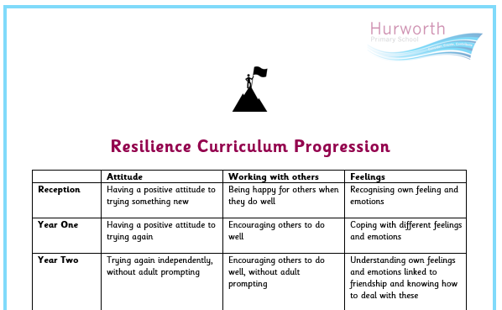
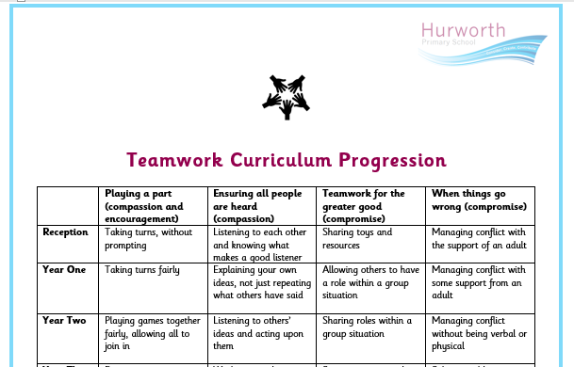
School Values

Slide 5









Pillars of
PD
RSE/PSHE
Citizenship
Character
Equality
FBV
Extra-
Curricular
Careers
Healthy
Lifestyle

Slide 6








PSHE/
RSE
Supporting Documents:
RSE Policy
PSHE Curriculum
Online Safety Curriculum
Assessment Trackers
Six key themes running through our progressively planned PSHE curriculum (R-Y6):
Revisited and built upon across school – develops progressively. Recognise that these themes overlap, however each unit of work focuses in on the main theme.
Six key skills that children develop through PSHE:
Rights
and Responsibilities
Feelings
and Friendships
Money
and Finance
Health
and Wellbeing
Identity
Safety
and Risk

Slide 7
PSHE/
RSE
Meets expectations of RSE Statutory Guidance and goes beyond, for example:
  Money and finance thread
  Risk and safety links to the local context (water safety, road safety, rail safety)
  Enrichment
The curriculum is carefully planned to address key areas before they arise e.g. puberty is taught in Year 4
Social and safety concepts are developed through the curriculum, including personal space and privacy, consent and grooming.
Online safety is taught through PSHE and Computing and is mapped out to ensure all areas are taught and revisited across school.
The curriculum is set but it is reactive and flexible to unplanned but important local, national and global issues as they arise through assemblies and class collective worship. This coincides with the DfE’s guidance that flexibility is important as it allows schools to respond to local public health and community issues, meet the needs of their community and adapt materials and programmes to meet the needs of pupils.
Protected characteristics are interwoven throughout the curriculum.
Sticky knowledge is identified so staff know what to emphasise and revisit.
Key vocabulary is laid out within medium term plans and is used by staff and children. Links are made to key texts.

Slide 8
PSHE/
RSE
To ensure that those who need to protect themselves the most understand how to keep themselves safe:
  Key content planned
  Curriculum for all document
  Reducing cognitive overload
  Post teach
  Use of assessment
  Pre and post teach
  Overlearning (flashback 4)
PSHE is planned, monitored and assessed in line with all Foundation Subjects, including use of:
  Observations
  Pupil voice
  Book looks
  Staff voice
  Low-stakes quizzes
  Tracking of data

Slide 9
PSHE/
RSE
LTP
 | Block 1 |  | Block 2 |  | Block 3 |  | Block 4 |  | Block 5 | Block 6
Reception | How do we behave in school? | How can we communicate online? | How can we make friends? | How can people be unkind online? | How do we keep our private parts safe? (NSPCC Pantosaurus) | Who keeps us safe | What are the rules when using technology online or at school? | How can we learn to care for ourselves? |  | How can we prepare for change?
 |  |  |  |  |  | and healthy?
Year 1 | How do we decide how to behave? | What information can I share online? | How do we feel? | How can we keep my information private online? | When do I talk to an adult? (Stranger Danger) | What makes us special? |  | How can we be kind online? | How can we be healthy? | How can we keep safe?
Year 2 | How can we help ourselves and others? | How can we ask for and give consent online? | How do situations make us feel and what does bullying mean? | What rules should I follow when using technology independently? | When is it okay to keep a secret? | How do we keep ourselves safe and clean? | Who does content on the internet belong to? | What is the same and different about us? | How can we get money and what can we do with it? | How can we keep safe in different places?
Year 3 | What are the rules that keep us safe? | What does identity mean online? | What are we responsible for? | What is appropriate behaviour online? | How do we set appropriate boundaries in friendships? | How can we stay safe online and when using social media? | How can we use the internet safely? | How can we look after our physical and mental health? | What can we do about bullying? | What jobs would we like to have?
Year 4 | How can we have positive relationships? | How can we show respect to others online? | How do we grow and change? | How can we find reliable information online? | When is it appropriate to talk about our body parts? | What is diversity? | Can we use other people’s online content? | How can we understand our feelings? | What makes us enterprising? | How can we keep safe in our local area?
Year 5 | What does discrimination mean? | What is online bullying and how can we combat it? | How do we grow and change? | What data do we share online? | How can we deliver basic first aid? | What makes a community? | How can we be healthy online? | What are healthy choices? | How does finance impact on people’s lives? | How can keep ourselves safe as we become more independent?
Year 6 | What are our rights? | How can we create a positive online presence? | How do we grow and change? | How can we report online bullying? | Why is consent important? | What makes a healthy and happy relationship? | How can we manage our privacy and security online? | How can money affect us? | How can we stay healthy? | How can social media affect us?

Slide 10
PSHE/
RSE
Online Safety
Online safety is taught within our PSHE curriculum and the Digital Literacy component of our computing curriculum. Our online safety curriculum is taught using the National Online Safety resources. We have linked their key concepts to our PSHE key concepts. These are identified on our long term plan.
Rights and Responsibilities
Online Reputation
Feelings and Friendships
Online Relationships
and Online Bullying
Money and Finance
Copyright
and Ownership
Health and Wellbeing
Health, Wellbeing
and Lifestyle
Identity
Self-Image
and Identity
Safety and Risk
Managing Online Information and
Privacy and Security
 | Block 1 | Block 2 | Block 3 | Across the year
 | Within computing slot | Within computing slot | Within PSHE slot | Within PSHE slot
Reception | How can we communicate online? | What does being unkind online mean? | What are the rules when using technology at home and at school?
Year 1 | What information can | How can we stay safe on the internet? | How can we be kind online?
 | we share online?
Year 2 | How can we ask for and give consent online? | What rules should we follow when using technology independently? | Who does content on the internet belong to? | How can we stay safe in different places?
Year 3 | What does identity mean online? | What is appropriate behaviour online? | How can we find balance when using technology? | How can we stay safe online and when using social media?
Year 4 | How can we maintain safe and healthy relationships online? | How can we find reliable information online? | Can we use other people’s online content?
Year 5 | What is online bullying and how can we combat it? | What data do we share online? | How can we be healthy online?
Year 6 | How can we create a positive online presence? | How can we address online bullying? | How can we manage our privacy and security online? | How can social media affect us?

Slide 11
Citizenship
We ensure children are ready to leave Hurworth Primary School by encouraging them to take an active part in society. Citizenship is an opportunity to ‘do’ as well as ‘know’.
Our behaviour policy sets out high expectations for the children through our school rules, clear boundaries, school values and a consistent approach throughout the school.
We aim to mirror children’s experiences to reflect our local context and give them a window into living in a modern, diverse British society, for example:
  Exposing children to a rich variety of texts which represent a range of cultures and experiences
  Providing opportunities for enrichment linked to our local area
  Planning school trips, visits and residential experiences to allow children to experience life beyond a village
Supporting Documents:
Speaking and Listening Curriculum
PSHE curriculum
Picture News
Enrichment overview
Behaviour Policy

Slide 12
Citizenship
Some examples of how we develop citizenship at Hurworth Primary are:
  PSHE curriculum
  Assemblies and class collective worship
  Junior Leadership
  Speaking and Listening curriculum, including opportunities for respectful debate and discussion across the curriculum
  Debating club (KS2)
  Voting for school councillors
  Friday Book Vote
  Work with charities
  Support advertising of local events
  Pupil of the Week linked to values
  Value nominations
  Choice of texts

Slide 13
Supporting Documents:
Vision and Values
The Hurworth Way
School displays
Character
At Hurworth Primary School, we see ourselves as a family and, as such, we want to ensure that every child has access to the best start in life and are nurtured and supported so they can demonstrate the ‘best version’ of themselves with the hope that they achieve their dreams and fulfil their potential.
The aim of our school is to develop children’s character through positive relationships and attitudes to learning, resilience, kindness and humility. We recognise the importance of broadening our children’s views and experiences beyond Hurworth to the rest of Britain and the wider world.
We have a set of guiding principles to develop children’s characters:
  The Hurworth Way
  Our Shared Language
Our vision and values sets out our 6 core values and sub-traits, alongside progression documents for independence, resilience, teamwork and independence away from home. These values are taught through our PSHE and RE curriculums and rewarded following our behaviour policy.
Children have the opportunity to develop character through a range of Junior Leadership responsibilities.

Slide 14

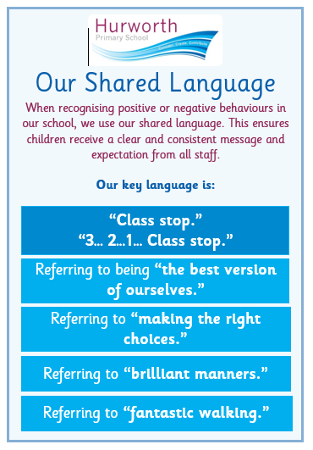
Character

Slide 15
Supporting Documents:
PSHE curriculum
Accessibility Plan
Equality Policy and Objectives
SEND Feedback
Equality
We ensure that we comply with the Equality Act (2010) through our:
  Equality Objectives and Policy
  Accessibility Plan
  PSHE and the wider curriculum
Our core values include Fairness and Respect, linking to the Fundamental British Values of Mutual Respect and Tolerance and Individual Liberty, encouraging children to demonstrate these in all aspects of their lives.
Children are taught about the protected characteristics throughout the PSHE curriculum, with some being explicit teaching and some being intrinsically linked to the planned areas of the curriculum.
We ensure that the protected characteristics are reflected in the texts and significant individuals we have chosen to study across the whole curriculum. Difference is celebrated and promoted across the school. Stereotypes are addressed within the PSHE curriculum.
We celebrate a range of different events throughout school, including through our curriculum and our school assemblies, ensuring to represent a range of people, cultures and faiths.
All children are encouraged to apply for Junior Leadership roles and responsibilities and they are appointed in line with the Equality Act.

Slide 16
Supporting Documents:
Assembly Overview
Vision and Values
Picture News Overview
FBV
Our school values are linked to the Fundamental British Values of:
  The Rule of Law
  Mutual Respect and Tolerance
  Democracy
  Individual Liberty
Each PSHE and RE unit of work is linked to our school values and Fundamental British Values. These are taught and referred to within these, showing children that these are not upheld across the globe and are special and important. Fundamental British Values are acknowledged across the wider curriculum and through school life as a whole.
Our ‘The World and Events’ assembly makes explicit links to Fundamental British Values.
Key texts chosen across the curriculum represent a range of cultures. We make links to our school values through these, which in turn reflect our Fundamental British Values.
Children have a range of wider experiences and visits which allow them to deepen their understanding of the Fundamental British Values and develop and demonstrate skills and attitudes that will allow them to participate fully in and contribute positively to life in modern Britain.

Slide 17
Extra-
Curricular
We offer a range of extra-curricular clubs after school. We ensure that these extend beyond sport and offer opportunities for children to develop their interests and hone their talents above and beyond our planned curriculum.
We ensure that all children have the opportunity to access extra-curricular clubs and monitor the uptake to ensure this. Children who do not participate are strongly encouraged to engage in at least one activity.
We develop character through our playtimes. Our Sports Crew leads physical activities to encourage children to be active for at least 60 minutes per day. Children learn how to develop our school values through the development of relationships and social skills.
Each term, the children have the opportunity to participate in an enrichment activity, where they learn to apply the school values in different contexts. These include opportunities to:
  Explore our local area
  Be enterprising and volunteer
  Express themselves and be creative
  Develop life skills
  Find new interests
Supporting Documents:
Extra-Curricular Overview, map and certificates
Enrichment Overview
Trips and Experiences Overview
Social Media Posts
Floor Books

Slide 18
Extra-
Curricular
AS A SCHOOL, WE PROMOTE THE DEVELOPMENT OF THE ‘WHOLE CHILD’ THROUGH CAREFULLY PLANNED ENRICHMENT OPPORTUNITIES.
Enrichment

Slide 19
Supporting Documents:
Subject MTPs
Junior Leadership resources
PSHE Curriculum
Careers
We aim to raise children’s aspirations and open them up to the world of work through exposing them to a range of careers across the curriculum.
Our PSHE curriculum has Money and Finance as one of the core themes. This introduces children to the concepts of money, including how much things cost, how to save, how to spend wisely and what having a job entails.
As one of their enrichment opportunities, all children are expected to plan and organise an enterprise activity, teaching them about the value of money.
Professionals are invited into school to link to our curriculum areas. We also make links to careers when inviting other visitors into school or when going on trips and experiences.
Children apply for Junior Leadership roles, school council and pupil ambassadors, giving them the opportunity to write application letters, deliver presentations and participate in interviews.
Alongside these opportunities which prepare children for their next stage and the future, we also provide extended transition between year groups (including to Year 7) for children who require it, allow them to walk home independently and give them the opportunity to be independent away from home.

Slide 20
Healthy
Lifestyle
To ensure children understand how to keep themselves healthy and to promote active lifestyles, we provide opportunities for the following:
  Explicit teaching through our PSHE, PE and Science curriculums
  After school clubs
  Sport Competitions
  Children’s Mental Health Week
  Healthy school dinners
  Daily fruit (R and KS1)
  Access to supportive listening, our school counsellor and Darlington Mental Health Support Team (Y4-6)
  Daily active 60 minutes – including active breaks and Sports Crew
  Open access to water bottles
  Safe space – Talking Sofas
We conduct the Darlington Healthy Lifestyle each year and these are reviewed by the PSHE team and SLT. This influences future planning, allowing us to emphasise points further within the curriculum or arrange additional support and expertise.
Our SENCo leads on Mental Health and PSHE.
Supporting Documents:
Extra-Curricular Overview
PE Curriculum
PSHE Curriculum
Science Curriculum
Dinner Menu
Pupil Voice

Slide 21
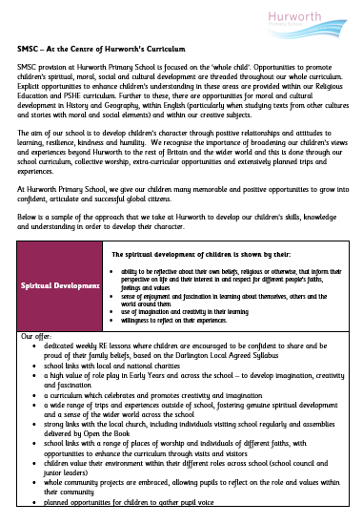
Supporting Documents:
SMSC Overview
Assembly Overview
SMSC
Our personal development offer contributes strongly to our approach to developing SMSC at Hurworth Primary School. Our Personal Development Pillars and wider curriculum areas link to the SMSC areas as follows:
  Spiritual: RE, assemblies, arts and sciences
  Moral: Character
  Social: Extra-Curricular
  Cultural: Citizenship, Fundamental British Values, Equality
We have set out how we approach SMSC at Hurworth Primary School in the following document:

