Slide 1

Year 6
Information Meeting

Slide 2
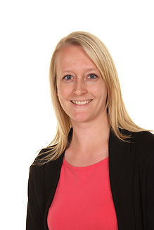
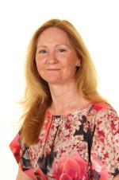
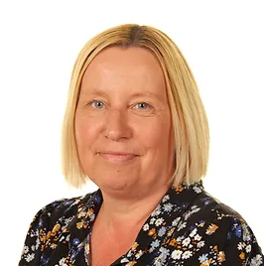
Staff
Mrs Yates
Year 6 Teacher
Assistant Head Teacher
Mrs Sellars
Year 6 Teaching Assistant
Mrs Maddison
Head Teacher

Slide 3
The School Day
Gates open at 8:45
Children can come straight to the Year 6 classroom (head towards the field & turn right. The Year 6 classroom is the first on the right)
Children will be assigned a shared locker just outside the classroom
There are pegs in the classroom
Any packed lunches are stored on a trolley just outside the hall. Water bottles will be easily accessible in the classroom
The school day ends at 3:20. Children should be collected from the school gate or can walk home by themselves if these arrangements have been confirmed by email or letter

Slide 4
Daily Routines
Mornings
Afternoons
Monday & Friday assemblies
English
Whole class reading
Class novel
Grammar, punctuation & spelling
Maths
Mindfulness
We Love to Read time
Arithmetic and fact fluency
Wider curriculum subjects
Tuesday, Wednesday & Thursday assemblies

Slide 5
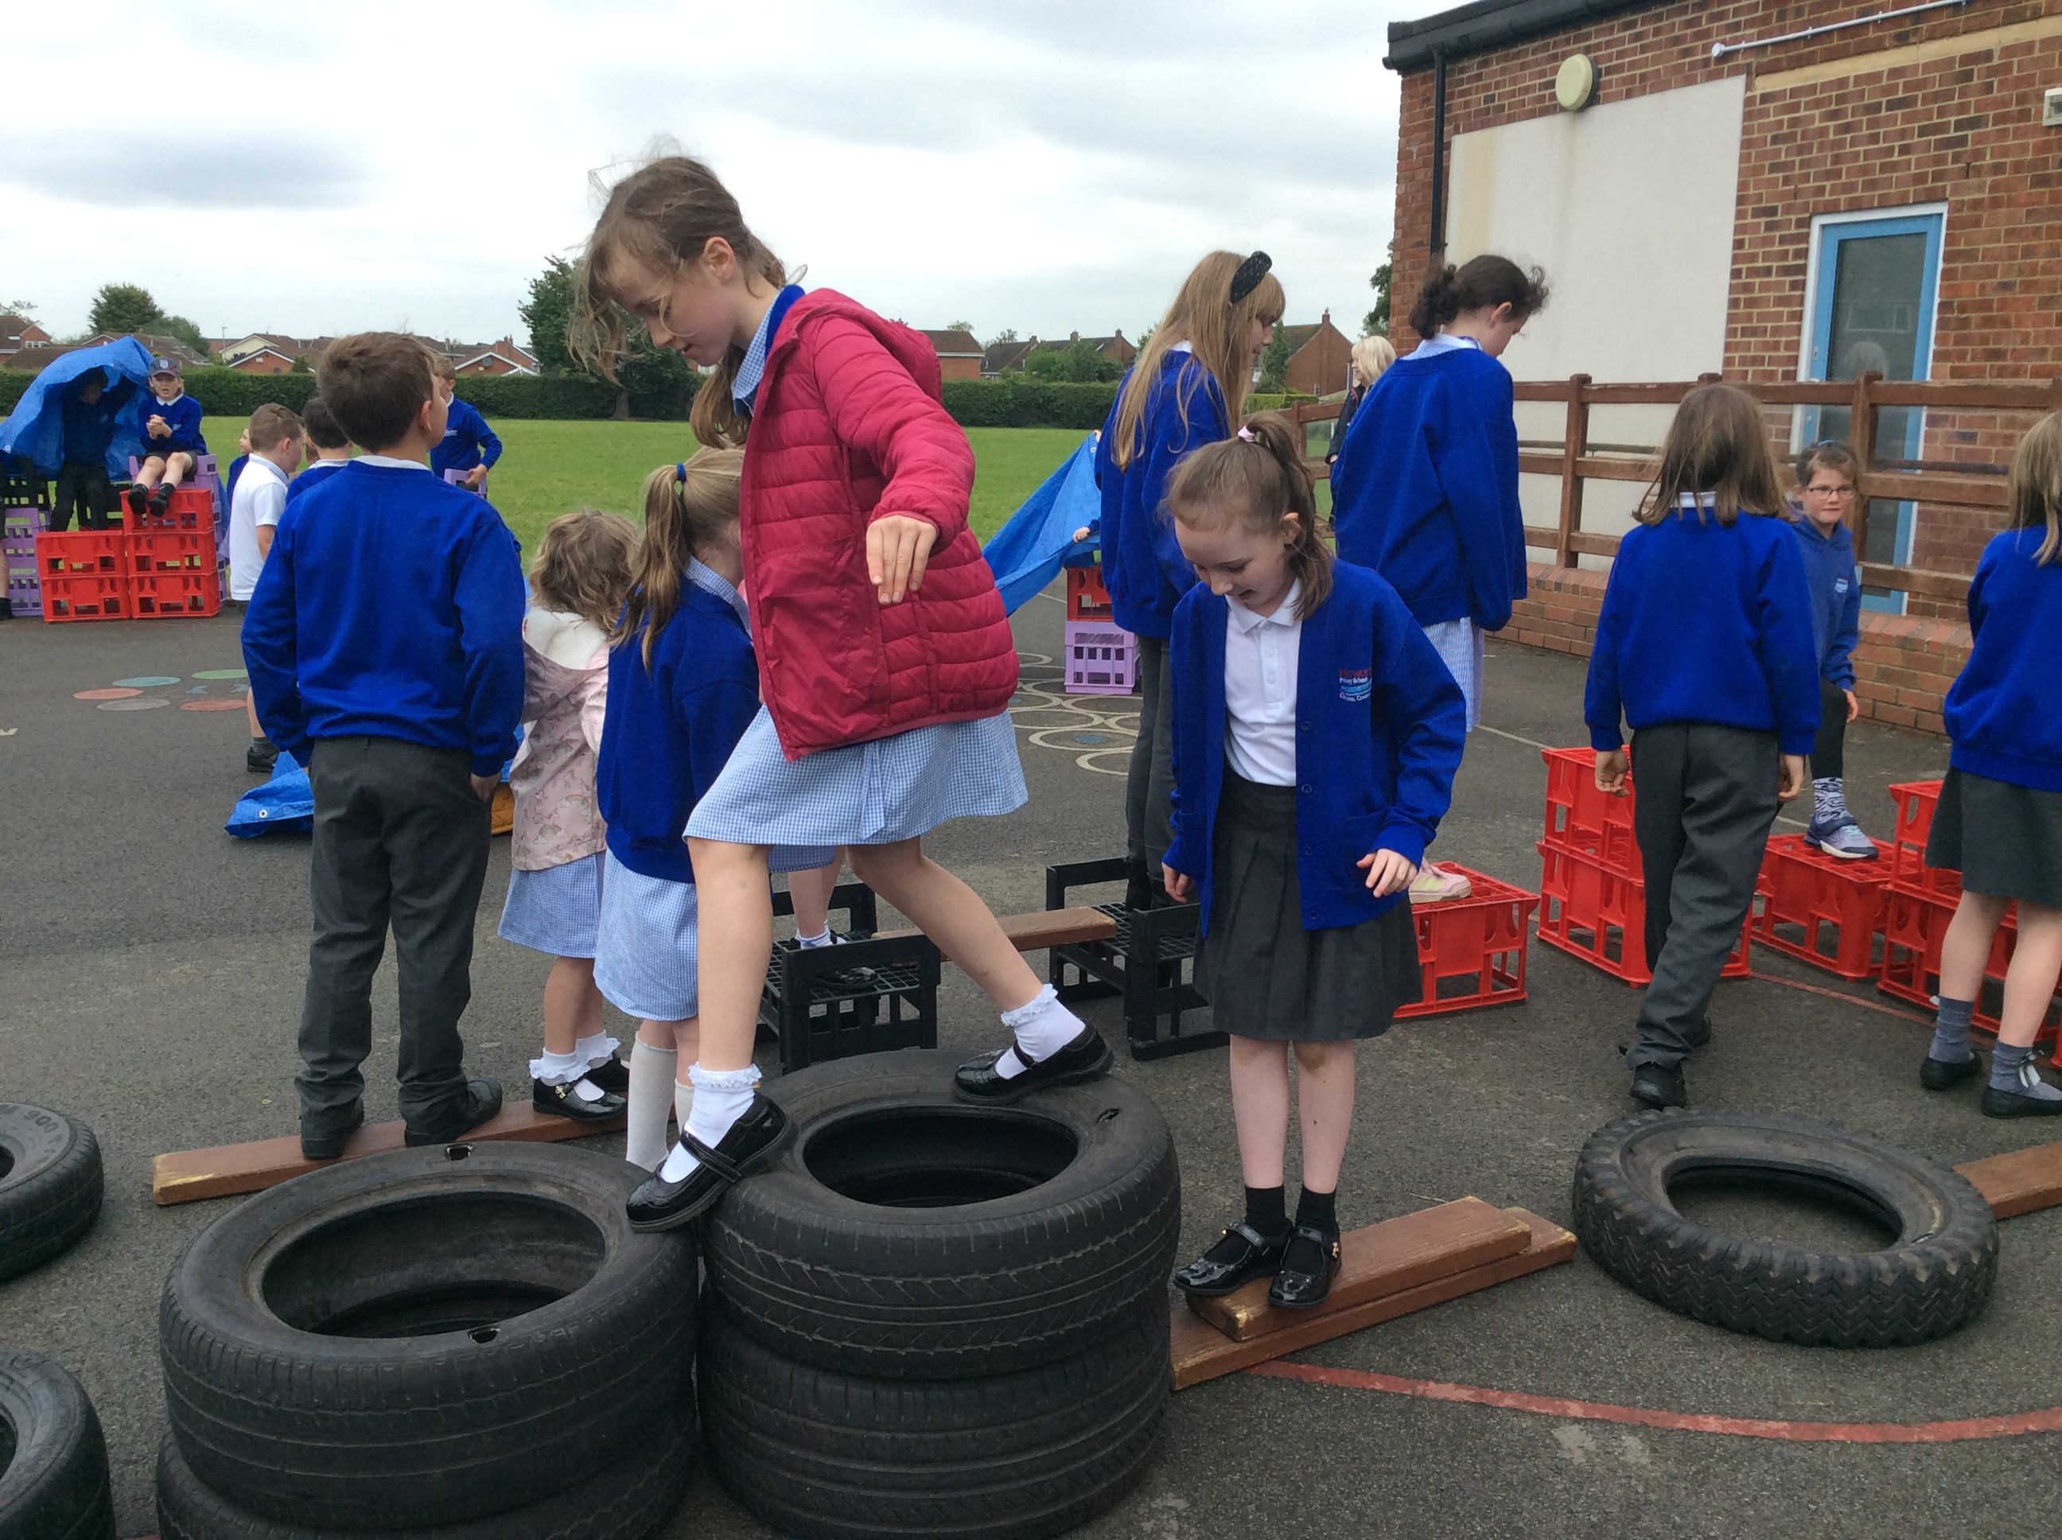
Daily Routines
Playtimes
Lunchtimes
10:30-10.45 with Years 4, 5, 6
Two playtimes each week will be on the MUGA
Children are welcome to bring in a nut- & sesame-free, healthy snack (e.g. fruit or vegetables)
Children should bring water in each day and, as a minimum, they will be encouraged to use playtimes and lunchtimes for drinks, as well as toilet trips
Our lunchtimes run from 12:00-1:00
We run a family system, where each family of children from across the school eats & plays together
At lunchtimes, the children can play across all of our areas

Slide 6
Uniform
Our school colours are royal blue, white & grey
Branded items can be purchased from Brigade. Branded items are not compulsory
Uniform expectations:
  Royal blue sweatshirt or cardigan
  Grey skirt, pinafore, trousers or shorts
  White polo shirt
  White or grey socks/black or grey tights (with skirts or pinafores)
  Sensible black shoes (no high heels or trainers)
  Blue & white gingham dress
Please make sure that all jumpers, cardigans, coats, hats & gloves are named

Slide 7
Uniform
Jewellery: For reasons of health & safety, jewellery is not to be worn at school. In those cases where children have pierced ears & need to wear earrings to school then these should be one set of single studs only. Smart watches should not be worn in school. Simple analogue or digital watches are permitted, but should not be used as a distraction
Hair: Children should have smart hair cuts. Radical designs & hair dye are strongly discouraged
Make Up: It is not appropriate for children to wear make-up or nail varnish
We aim to avoid designer products (bags, coats, water bottles)

Slide 8
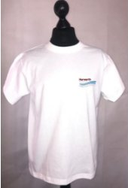
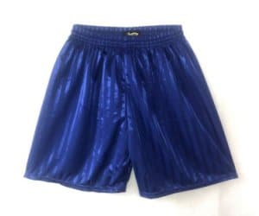
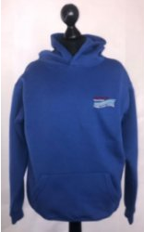
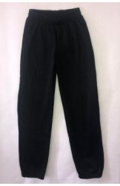
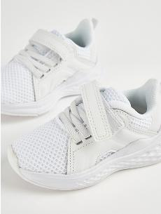
PE
Thursday is the Y6 PE day
Children should come to school in their PE kit
They will need appropriate clothing for the weather (sunhats for warm weather, waterproof coats & hats for cold weather)
All jewellery must be removed before PE. If your child is wearing earrings, please ensure that they can remove their own or that you provide plasters to cover them
Please avoid fashion, branded or patterned sportswear
Please make sure that all hoodies are labelled with your child’s name
Royal blue shorts
White T-shirt (available with school logo)
Royal blue hooded sweatshirt (available with school logo)
Long, plain jogging bottoms or leggings
Trainers

Slide 9
Statutory Assessment
Key Stage 2 Tests (national curriculum assessments, commonly known as SATs)
Measure pupils’ attainment in relation to standards set out in the national curriculum
Monday 11th May 2026: English grammar punctuation & spelling (papers 1 & 2)
Tuesday 12th May: English reading
Wednesday 13th May: Mathematics arithmetic & reasoning (papers 1 & 2)
Thursday 14th May: Mathematics reasoning (paper 3)
No test for writing. This is teacher assessment based on the child’s overall work & performance. There is an external moderation process

Slide 10
National Curriculum
English (reading, writing, spelling, handwriting)
Maths
Science
Computing
Music
PE (including a block of swimming in Autumn 1)
PSHE
RE
Science
Geography
History
Art & Design
Design & Technology
Spanish

Slide 11
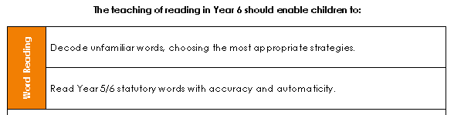
Reading Expectations

Slide 12
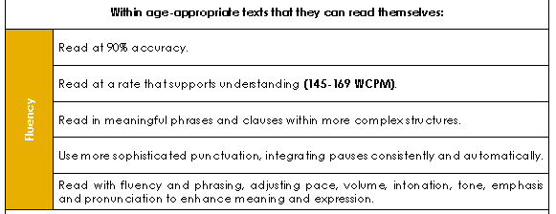
Reading Expectations

Slide 13
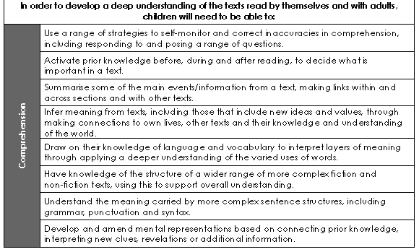

Slide 14
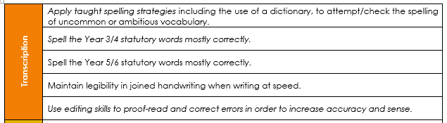

Writing Expectations

Slide 15
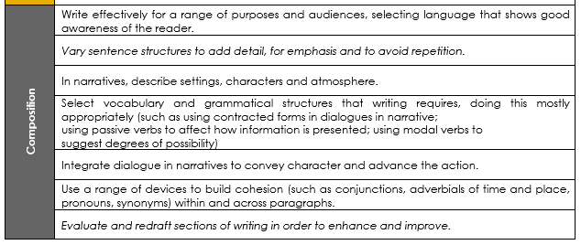
Writing Expectations

Slide 16
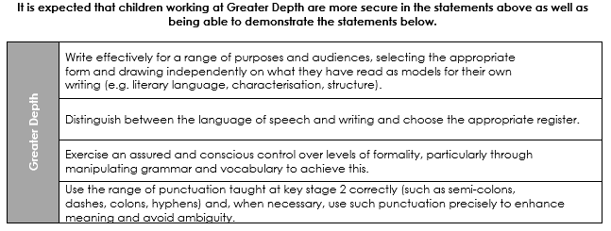
Writing Expectations

Slide 17


Slide 18
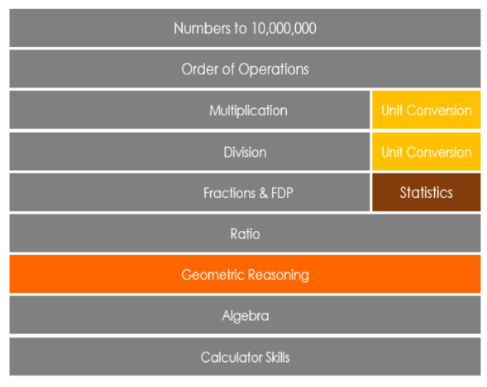
Maths Expectations

Slide 19
Maths Expectations
Read, write, order & compare numbers up to 10,000,000
Rounding to a given value
Multiply & divide using the formal written method (including short & long multiplication & division)
Solve multi-step problems
Add & subtract fractions with different denominators & mixed numbers
Multiply & divide fractions
Use ratio to solve problems
Use negative numbers in context
Convert between units of measure
Draw & translate simple shapes
Interpret & construct pie charts & line graphs

Slide 20










The Wider Curriculum
At School
Healthy Lifestyle
At the Weekend
Me in the World
Where do we live?
How are Earth’s natural resources distributed?
Rounders, football, badminton, tag rugby, dance, athletics, swimming
How has crime and punishment changed?
Why did Darlington flourish in the Industrial Revolution?
Why did WWII begin & what part did the people of Darlington play?
Coding
Blogging
Spreadsheets
Brass
Landscape drawing
Portrait painting
Animal sculpture
Rights
Online safety
Healthy relationships
Money
Growing & changing
Staying healthy
Evolution
Light
Electricty
Building
Sewing
Cooking

Slide 21

Homework
Handed out on Monday & returned on Friday
New spelling rule introduced on Monday
Practised 5 times in school through different activities & also sent home for practice
Spelling quiz on Friday (4 words from that week’s list, 2 new words using that same spelling pattern, 2 of the year group words & 2 words from previous weeks)

Slide 22
Reading at Home
All children are expected to read at least three times per week at home
Children are welcome to choose their own books from our bookshelf or from the library & can change it whenever they finish
Children can record their own reading. We request that an adult checks this & signs it off before reading records are checked on Friday
Children will also read in school throughout the week so please ensure their reading book & record are in their bags each day
Children who have read three times will receive a bookworm treat & their names will be entered into our half-termly raffle to receive a book token

Slide 23
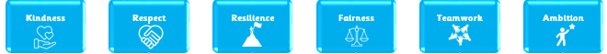
School Values
To support our children to be the best versions of themselves, we teach the children about our school’s six core values.
We recognise that, in society, not all people uphold these values and so we ask in your support in modelling and instilling these values at home.
Some examples include:
  Fairness and Respect: making sure that children of any gender are treated equally
  Kindness and Respect: making sure that nobody is judged for being different
  Resilience: knowing that it is okay to make mistakes; the important thing is to learn from them and move on
  Teamwork: knowing that everyone in our school family is part of our team
  Ambition: understanding that we should try to be the best version of ourselves

Slide 24
Independence
 | Pride | Have a Go | Basics | Responsibility | Educational
Year Five | Take responsibility & have pride in their own appearance, including their work | Support others when the need arises, using own initiative | Keep classroom resources ready to use & ensure that they are tidied away afterwards | Hand in homework which may have different deadlines during the week. Ensure they collect their own homework if they were absent on day it was issued
Year Six | Tackle open ended tasks & investigations without need for support | Without prompting, check, edit & improve their own work & that of others | Manage their own behaviour when no adult is present | Fulfil the school responsibilities & coordinate & run certain school activities without seeking reassurance
We acknowledge that some children with Special Educational Needs may not be able to have the same level of independence as their peers as a result of their needs. Careful consideration will always be given to each individual so that they make progress & become the best version of themselves.

Slide 25
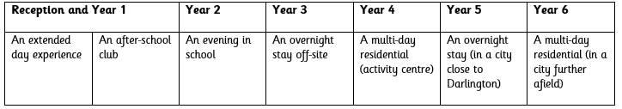
Trips & Experiences
To help to encourage the children to become independent, we are going to be providing a variety of clubs, trips & enrichment experiences
In Year 6, our trips will include:
  Kirkleatham Museum (science); Baltic (art); Beamish (history); Durham University (PSHE)
One of our enrichment experiences will link to enterprise.
Our ‘Independence Away From Home’ Progression

Slide 26
Online Safety
We know lots of children are accessing YouTube videos that are not suitable and games that are beyond their age range.
Please ensure parental controls are set on any device that your child has use of. We can help with this if you are unsure how to set them.
Use Parental Controls to Keep Your Child Safe | NSPCC
We advise to limit screen time.
Notes:
Ensure that children are not being given a smart phone too soon – we know children are accessing YouTube videos that are not suitable and games beyond their age range

Slide 27




Keep Up to Date
You can find out more information about what the children are up to in school through our social media accounts
We also add termly information about the children’s learning & other useful information to the class pages on our school website: www.hurworthprimary.com
https://www.facebook.com/HurworthPrimarySchool/

Slide 28
Any questions?

