Slide 1

Year 4
Information Meeting

Slide 2
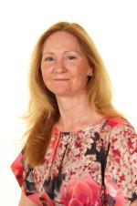
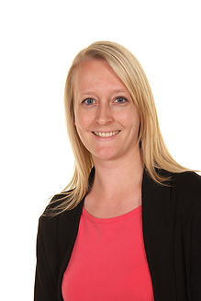
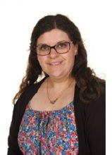
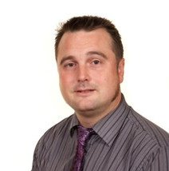
Staff
Miss Randall
Year 4 Teacher
Mr King
Year 4 Teaching Assistant
Mrs Maddison
Head Teacher
Mrs Yates
Assistant Head Teacher

Slide 3
The School Day
The gates open at 8:45 and the children can come straight to the Year 4 classroom. They come in through the gate towards the field and turn right. The Year 4 classroom is the third on the right.
There are pegs in the classroom for their coats and lockers are outside the classroom for them to store their bags. They share a locker with 1 or 2 others. Packed lunches are stored on a trolley in the street. After lunch they are put on their lockers after lunch, ready to go home.
The school day ends at 3:20. Children should be collected from the school gate.

Slide 4
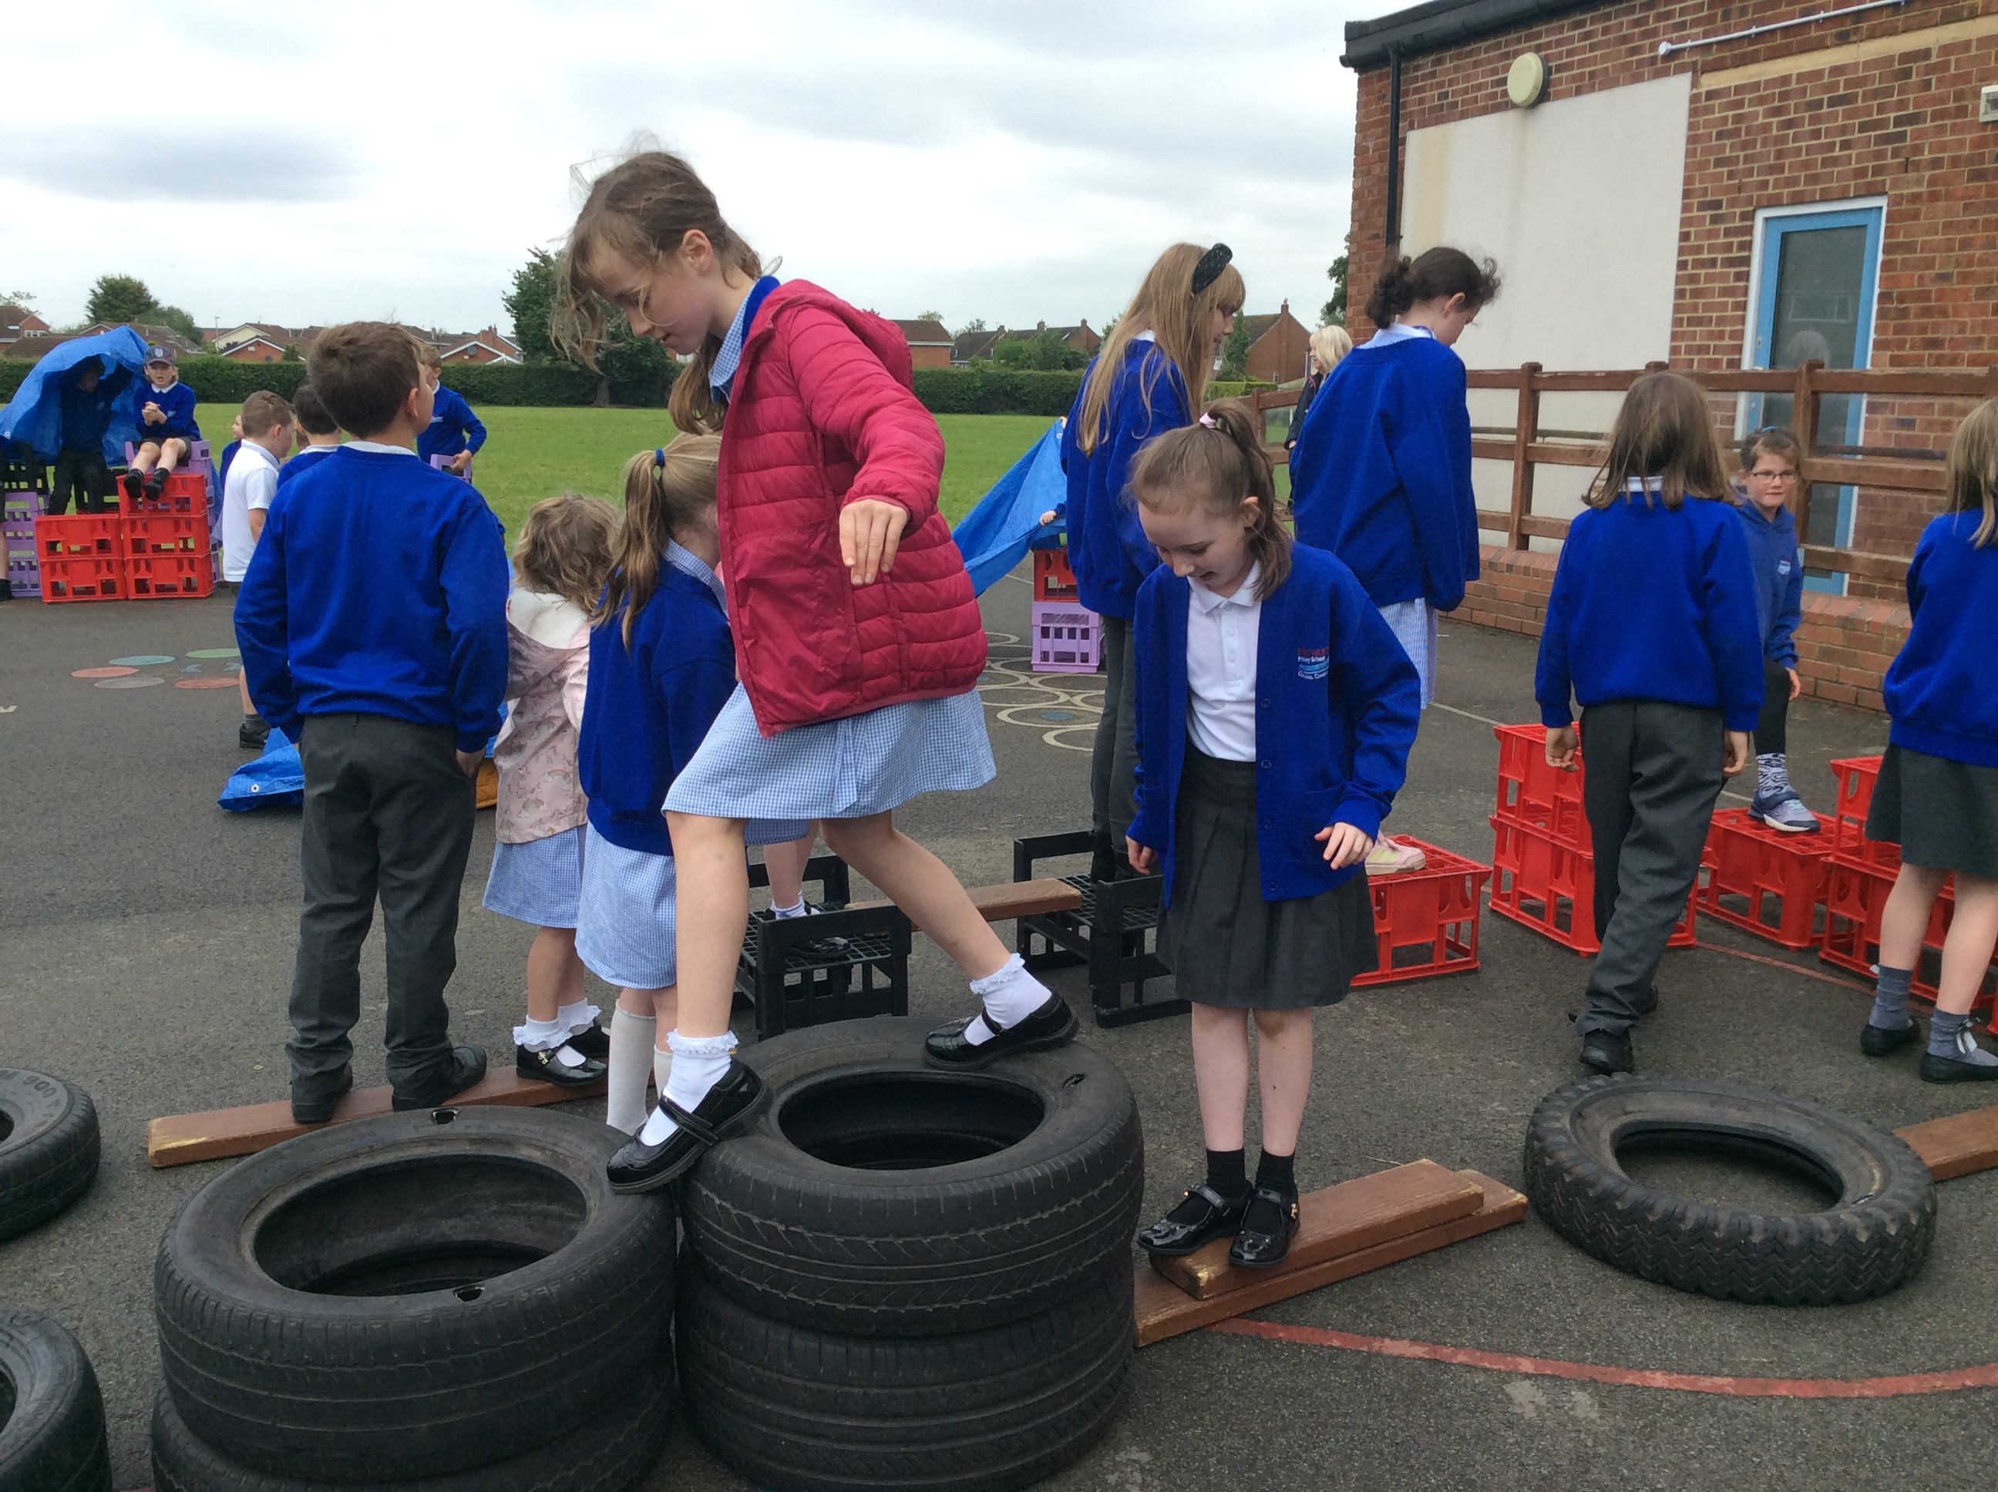
Daily Routines
Playtimes
Lunchtimes
10:30 – 10:45 with Year 3, Year 5 and Year 6
One playtime each week will be spent on the MUGA
Year 4 can bring their own snack (fruit and veg only)
Water bottles are always accessible and can be taken out on hot days if needed
Our lunchtimes run from 12:00 – 1:00.
We run a family system, where each family of children from across the school eats and plays together.
At lunchtimes, the children can play across all of our areas.

Slide 5
Uniform
Our school colours are royal blue, white and grey.
Branded items can be purchased from Brigade. However, no branded items are compulsory.
Uniform expectations:
  Royal blue sweatshirt or cardigan
  Grey skirt, pinafore, trousers or shorts
  White polo-shirt
  White or grey socks/black or grey tights (with skirts or pinafores)
  Sensible black shoes (no high heels/wedges, sandals or trainers)
  Blue and white gingham dress
Please make sure that all jumpers, cardigans, coats, hats and gloves are named.

Slide 6
Uniform
Jewellery: For reasons of health and safety, jewellery is not to be worn at school. In those cases where children have pierced ears and need to wear earrings to school then these should be one set of single studs only. Smart watches should not be worn in school. Simple analogue or digital watches are permitted, but should not be used as a distraction.
Hair: Children should have smart hair cuts. Radical designs and hair dye are strongly discouraged.
Make Up: It is not appropriate for children to wear make-up or nail varnish.
We aim to avoid designer products (bags, coats, water bottles).
Notes:
e.g. Stanley Cups, Air Up bottles

Slide 7
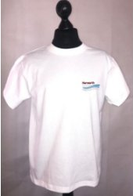
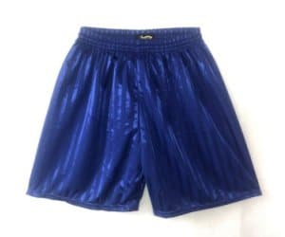

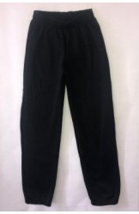
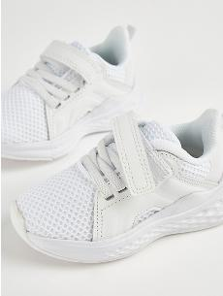
PE
PE will be on a Wednesday afternoon.
Children should come to school in their PE kit.
They will need appropriate clothing for the weather (sunhats for warm weather, waterproof coats and hats for cold weather.
All jewellery must be removed before PE. If your child is wearing earrings, please ensure that they can remove their own or you provide plasters to cover them.
Please avoid fashion, branded or patterned sportswear.
Please make sure that all hoodies are labelled with your child’s name.
Royal blue shorts
White T-shirt (available with school logo)
Royal blue hooded sweatshirt (available with school logo)
Long, plain jogging bottoms or leggings
Trainers

Slide 8
Statutory Assessment
Multiplication Tables Check
The purpose of the check is to determine whether your child can fluently recall their times tables up to 12x12, which is essential for future success in mathematics. It will also help your us to identify if your child may need additional support.
It is an on-screen check consisting of 25 times table questions. Your child will be able to answer 3 practice questions before taking the actual check. They will then have 6 seconds to answer each question.
From March, schools can use the check to try it out with children so that they become familiar with it. Soundcheck on TT Rockstars and Multiplication Check are replicas of the Multiplication Tables Check.
In June, there will be a window given to us to complete the check.

Slide 9
National Curriculum
English (writing, reading, spelling, handwriting)
Maths
Science
Computing
Music
PE
PSHE
RE
Science
Geography
History
Art
Design Technology
Spanish (KS2 only)

Slide 10
Reading Expectations
There are whole class reading sessions, class novels and reading groups
The key expectations are:
Decode unfamiliar words using an appropriate strategy
Read Year 3/4 statutory words with accuracy and automaticity
Read at 90% accuracy and at a rate that supports understanding (115-139 WCPM)
Read in meaningful phrases and use punctuation to pause (full stops and commas)
Self-correct and read with expression (volume and intonation)
Summarise main events
Respond to and pose questions throughout the text to clarify understanding
Infer on their own experiences and draw on the knowledge

Slide 11

Writing Expectations
The key expectations are:
Writing is of consistent size and is neat
Uses fronted adverbials (with a comma)
Use commas, inverted commas, apostrophes
Spell Year 3/4 statutory words and spelling patterns correctly
Use homophones correctly
Use correct verb tense
Structure and organise fiction and non-fiction texts
Use language and grammar to aid the reader
Use noun phrases to add detail and clarify
Use pronouns to avoid repetition

Slide 12
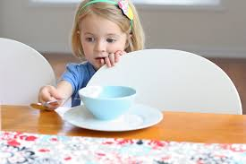
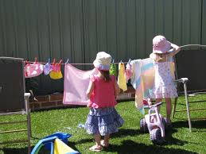
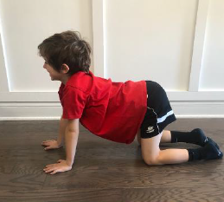
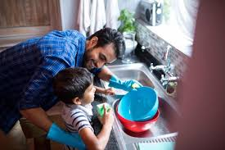
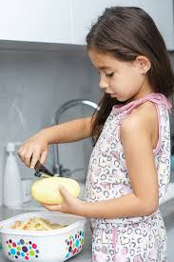
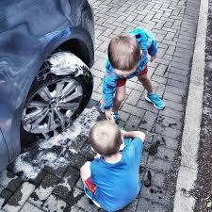

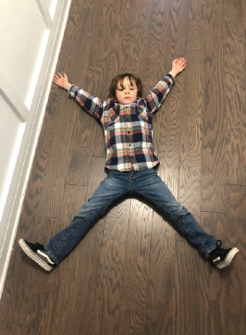
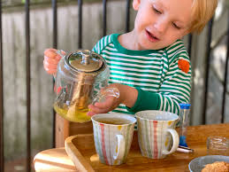
Supporting Handwriting
Handwriting isn’t all about sitting at a table with a pencil and paper! There are lots of other things the children can be doing at home that will benefit their handwriting.
Notes:
Things that can help:
Washing dishes
Washing car
Setting the table (and clearing away!)
Preparing the dinner
Pegging out the washing
Pouring with heavier cups
Yoga
Crossing midline exercises
Snow angels

Slide 13

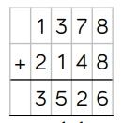
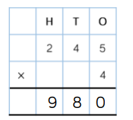

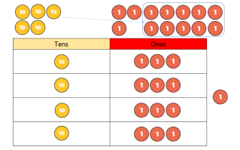
Maths Expectations
The key expectations are:
Recall multiplication and division facts up to 12x12
Recognise the place value of each digit in a four-digit number
Order and compare numbers beyond 1000
Recognise and show families of common equivalent fractions and know decimal equivalents of tenths, hundredths, quarter, half and three-quarters
Multiply two-digit and three-digit numbers by a one-digit number using a formal method

Slide 14
The Wider Curriculum
A more detailed overview will be added to the school website and emailed each term.
Hockey
Protecting Habitats
How do we grow and change?
Early Civilisations
Dance
Continents & oceans
Our Country
Sewing
The Roman Empire and Roman Britain
Islam
Badminton
Online safety
Drawing: Cityscapes
Coding
Sound
Swimming
How can we keep safe in our local area?
States of Matter
Humanism
Ancient Egypt
Christianity
Hinduism
Mountains, Earthquakes and Volcanoes
Electricity
Sculpture: The Human Form
Cooking
Painting: Still Life

Slide 15
Homework
Homework is to be handed out on Monday and returned on Friday.
Maths homework – linked to times tables learning. Practise 3 times a week on Times Table Rockstars.
Reading homework – More information on the next slide
Spelling homework – sent out on Monday. Spelling quiz on Friday which includes 4 words from the list, 2 using the same spelling pattern, 2 of the year group words and 2 words from previous weeks. Practise in whichever way you choose.
Children should be capable of completing their homework independently but may need a check in or know that they can ask for help if they need it.
Children should be fully responsible for their own homework including packing it away in their own bag ready to hand it in.

Slide 16
Reading at Home
All children are expected to read at least three times per week at home.
Children choose books from our school library from their level. Books will be available in the classroom for them to choose from when they need to change them. The children may move up a level after discussion with teaching staff.
There will be some fluency chapter books in Year 4, for children continuing on Little Wandle. These will be used during the week at school (for two weeks) then sent home on a Friday for over the weekend. These will also be put on as eBooks to read during the week.
Children can record their own reading. Please can an adult check this and sign it off before reading records are checked on Mondays. They can include books they read at home.
Children will also read in school throughout the week so please ensure their reading book and record are in their bags each day.
Children who have read three times will receive a bookworm treat and their names will be entered into our half-termly raffle to receive a book token.
Notes:
Model using the corner of the page to turn a book, rather than ‘swiping’.

Slide 17
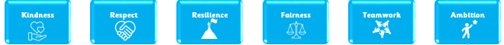
School Values
To support our children to be the best versions of themselves, we teach the children about our school’s six core values.
We recognise that, in society, not all people uphold these values and so we ask in your support in modelling and instilling these values at home.
Some examples include:
  Fairness and Respect: making sure that children of any gender are treated equally
  Kindness and Respect: making sure that nobody is judged for being different
  Resilience: knowing that it is okay to make mistakes; the important thing is to learn from them and move on
  Teamwork: knowing that everyone in our school family is part of our team
  Ambition: understanding that we should try to be the best version of ourselves

Slide 18
Independence
 | Pride | Have a Go | Basics | Responsibility | Educational
Year 3 | To take responsibility for what they need to bring to school, PE kit etc. | If they encounter a problem, try and self-solve this | Be able to clean own glasses (parents to provide wipes/cloth for children to do so) Know their own date of birth Know a contact phone number | Take complete ownership of their homework Ask teacher for homework if they have been absent If homework is a problem, ensure that they request support from the teacher prior to deadlines Change independently for swimming Get new equipment independently e.g. a new glue stick if it runs out | Know the timings of the school day and use an analogue clock to work out how long until the next transition point Sharpen own pencil
Year 4 | Try a solution before giving up. ‘I can’t’ is not used. | Use a range of strategies before asking teacher for help, e.g. peer support | Follow multistep instructions given by teacher without the need to ‘double check’ | Bring homework back on time and completed | Check through answers to assessments thoroughly.

Slide 19
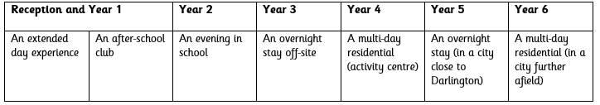
Trips and Experiences
To help to encourage the children to become independent, we are going to be providing a variety of clubs, trips and enrichment experiences.
In Year 4, some of our trips will include:
  Robinwood
  Segedunum
  Great North Museum
One of our enrichment experiences will link to enterprise. The children will run their own activities to fundraise for one of their trips in each year group.
Our ‘Independence Away From Home’ Progression

Slide 20
Online Safety
Please ensure your children are not given a smart phone too soon. We advise that children are in at least upper KS2 before they have their own smart phone.​
We know lots of children are accessing YouTube videos that are not suitable and games that are beyond their age range.​
Please ensure parental controls are set on any device that your child has use of. We can help with this if you are unsure how to set them. ​
Use Parental Controls to Keep Your Child Safe | NSPCC​
We advise to limit screen time.​
Notes:
Ensure that children are not being given a smart phone too soon – we know children are accessing YouTube videos that are not suitable and games beyond their age range

Slide 21




Keep Up to Date
You can find out more information about what the children are up to in school through our social media accounts.
We also add termly information about the children’s learning and other useful information to the class pages on our school website: www.hurworthprimary.com
https://www.facebook.com/HurworthPrimarySchool/

Slide 22
Any questions?

